Slide 1

Introduction to Canvas
Academic Technology
San Francisco State University
Notes:
Introduce yourself and role in AT

Slide 2
Overview
Accessing Canvas
User interface and navigation
Course content and layout
Student management
Activities and grading
External tools
Extras + Support
Notes:
Mention this is not a how to type workshop, but to help you all get a better feel for Canvas

Slide 3
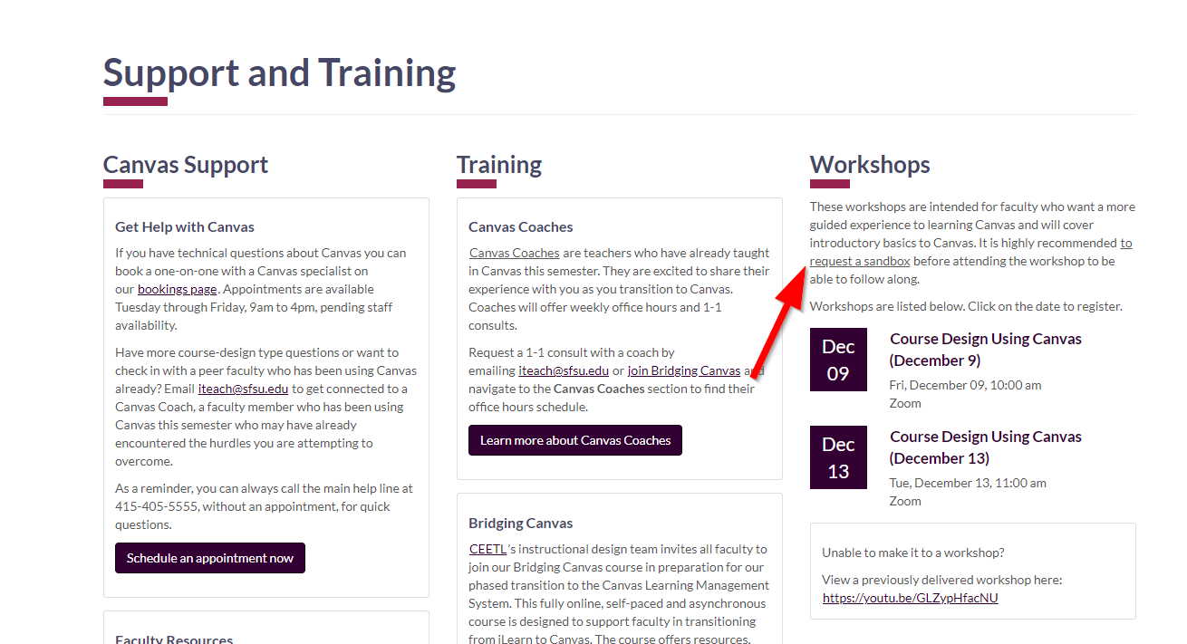
Getting access to Canvas
Spring 2023 courses are available in Canvas
Request a sandbox
https://canvas.sfsu.edu/canvas/support-and-training
Notes:
Explain what a sandbox is

Slide 4
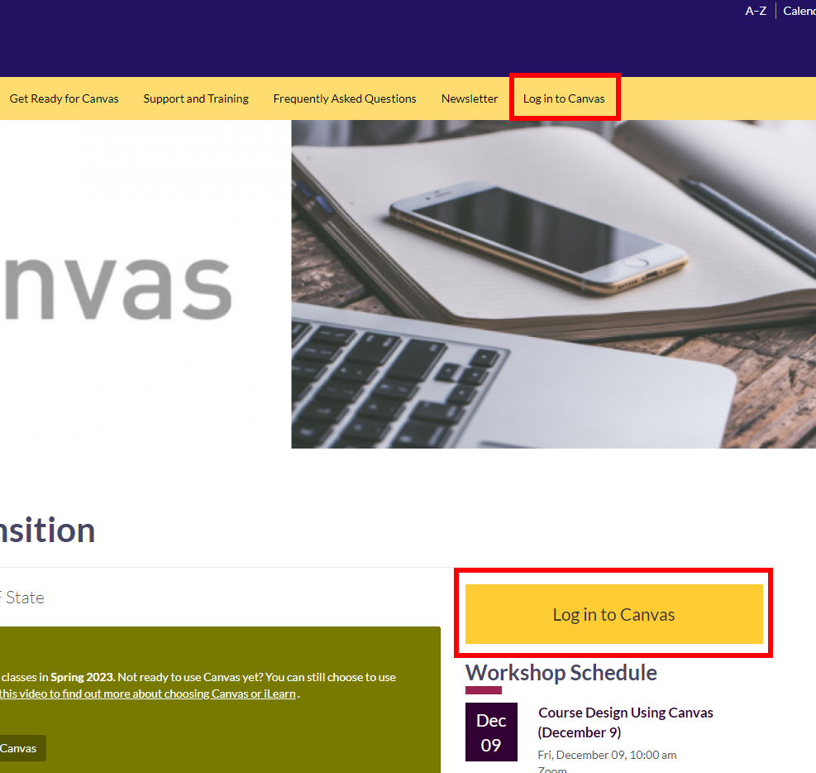
Logging in
First time login: https://canvas.sfsu.edu
Notes:
Mention iLearn login primarily if they have classes in both systems. Published Canvas courses appear in iLearn

Slide 5
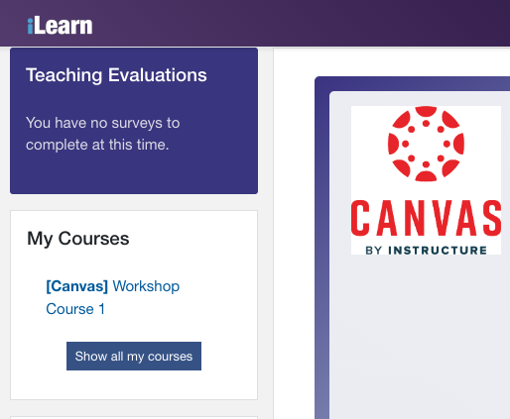
Logging in via iLearn
After your courses are published: https://ilearn.sfsu.edu
Students access: https://ilearn.sfsu.edu
Keep in mind students may have classes in both systems during the transition!

Slide 6
User interface and getting around

Slide 7
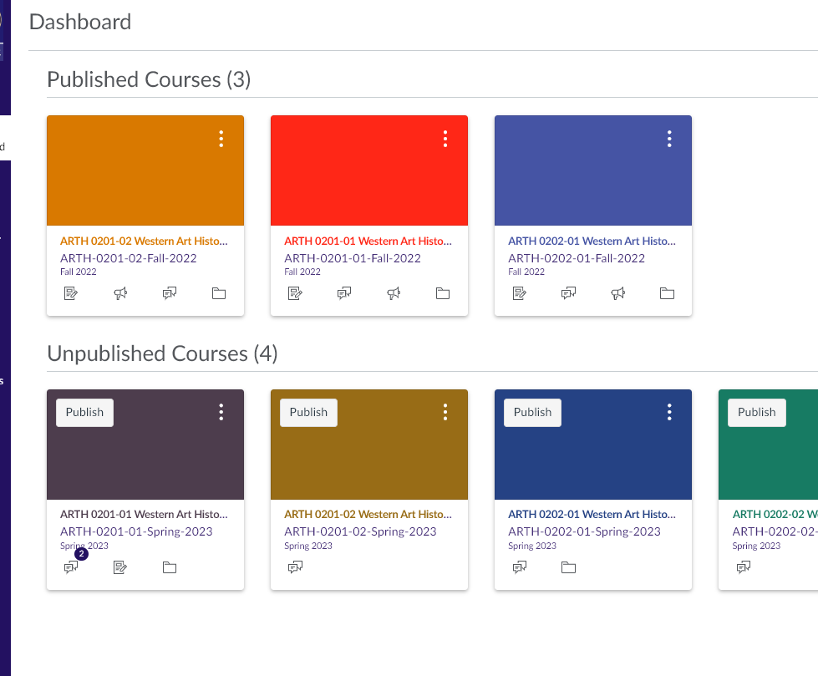
Canvas Dashboard and navigation
The Dashboard is the first thing you see after logging into Canvas.
Published courses are available to students.
Notes:
Main site navigation is on the far left in the purple bar. Top to bottom, account lets you access and edit your Canvas profile. Dashboard is the main front page. Courses is a list of all courses in the system that you are either teaching or taking. Groups will show you any groups in any courses you are a part of. Calendar will show any events across all courses that have dates attached. Inbox takes you to the built-in Canvas messaging system. History is a list of pages you’ve accessed recently (quick way to get back to places if you get lost). Commons is a list of courses and templates shared with the greater Canvas community that you can pull from.
Note the todo list and that it appears for instructors and students. For instructors it shows things that need to be addressed like discussion posts and items to be graded. For students it shows upcoming due dates

Slide 8
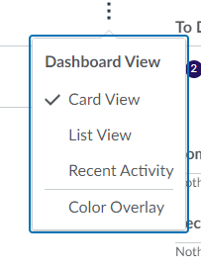
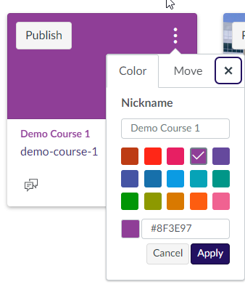
Dashboard customization
Dashboard has three views
  Card view
    Shortcut icons in each card to quickly access announcements, assignments, discussions and files
  List View
  Recent activity
Card view customization
  Card can have a different color set
  Card can have a unique image set
  Cards can be moved around
  Courses can have a nickname
    IMPORTANT: Nicknames and colors only show up for you! They do not show up for students. Students can customize their own dashboards and will not see your color OR nickname
Notes:
Three dots menu in top corner to change view. Card view shows each class as a card with a distinct color and a course picture, if set in the course. List view is a list of upcoming events across all courses. Recent activity is a list of activity, including student activity, across all courses.
Three dots menu in each card to customize card.

Slide 9
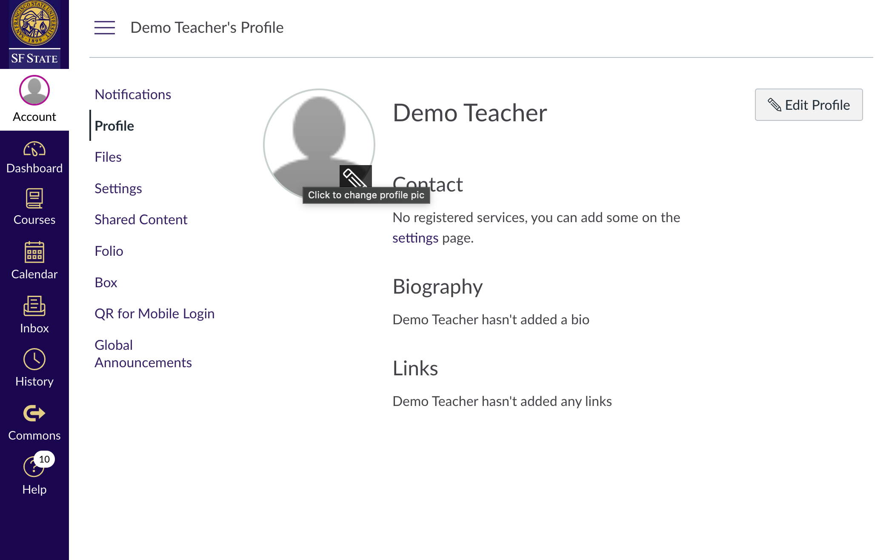
User profile
Similar to iLearn profile, a picture, quick bio and links can be set in Canvas.
Notes:
https://sfsu.instructure.com/courses/1549

Slide 10
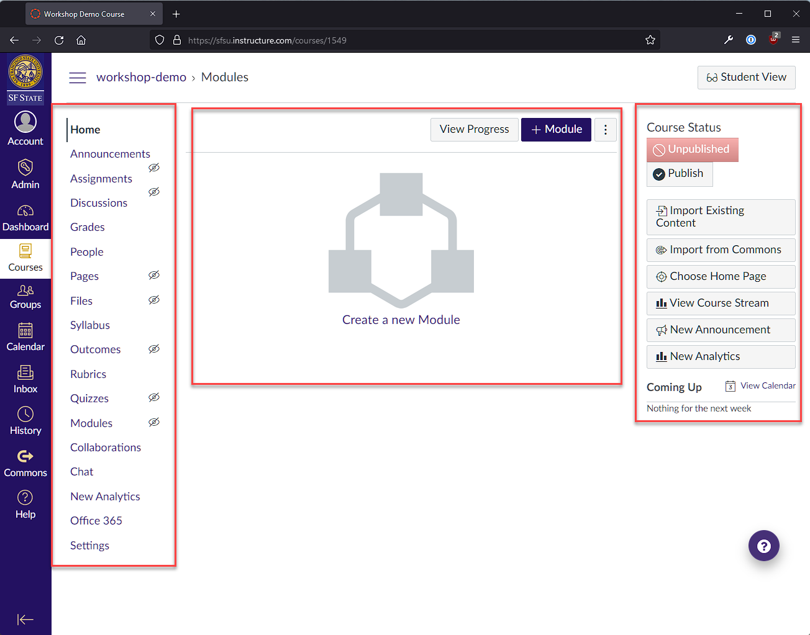
Main course page
The default “Home” page for each of your courses is automatically set to the Modules section.
Modules
Context aware menu
Course Navigation
Global Navigation
Notes:
Three column layout. Course navigation on the left, content in center, context aware menu on the right.

Slide 11
Course content and layout

Slide 12
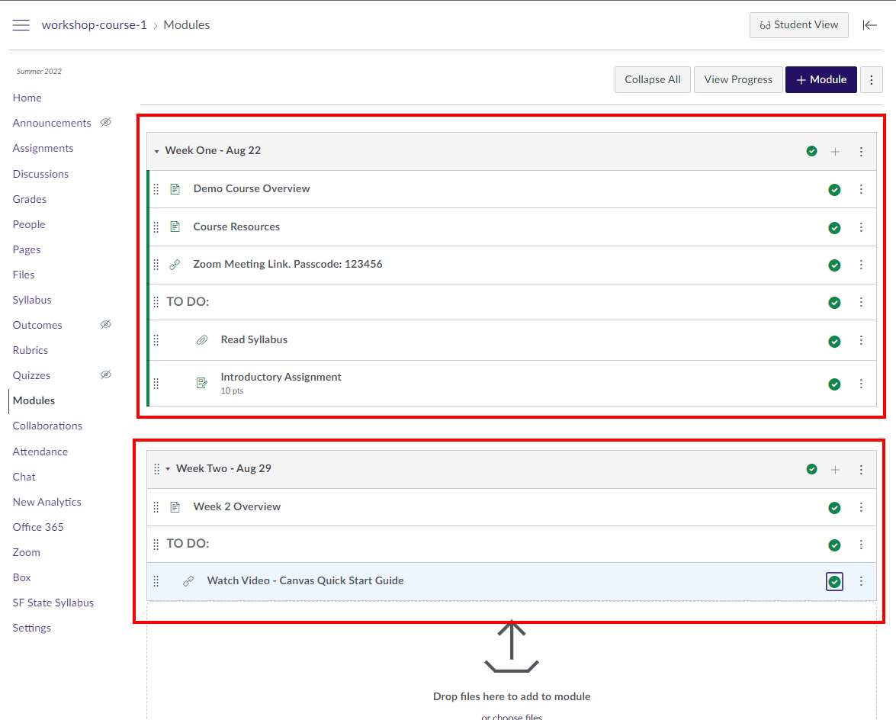
Modules
Similar to iLearn’s “sections” or “weeks”.
No set prescription on how to organize your course.
Has a “lock until” setting to release content on a set schedule.
Modules can be published individually.
There’s no “label” or “section summary” in Canvas modules. Instead, use Text Headers or ident levels.
No pictures or colored text.

Slide 13
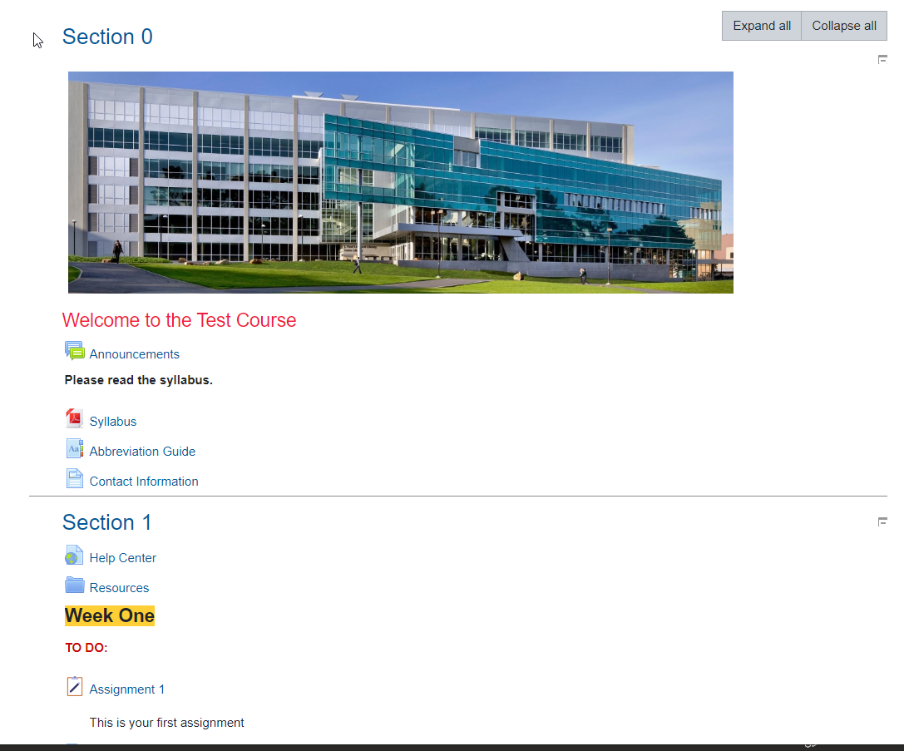
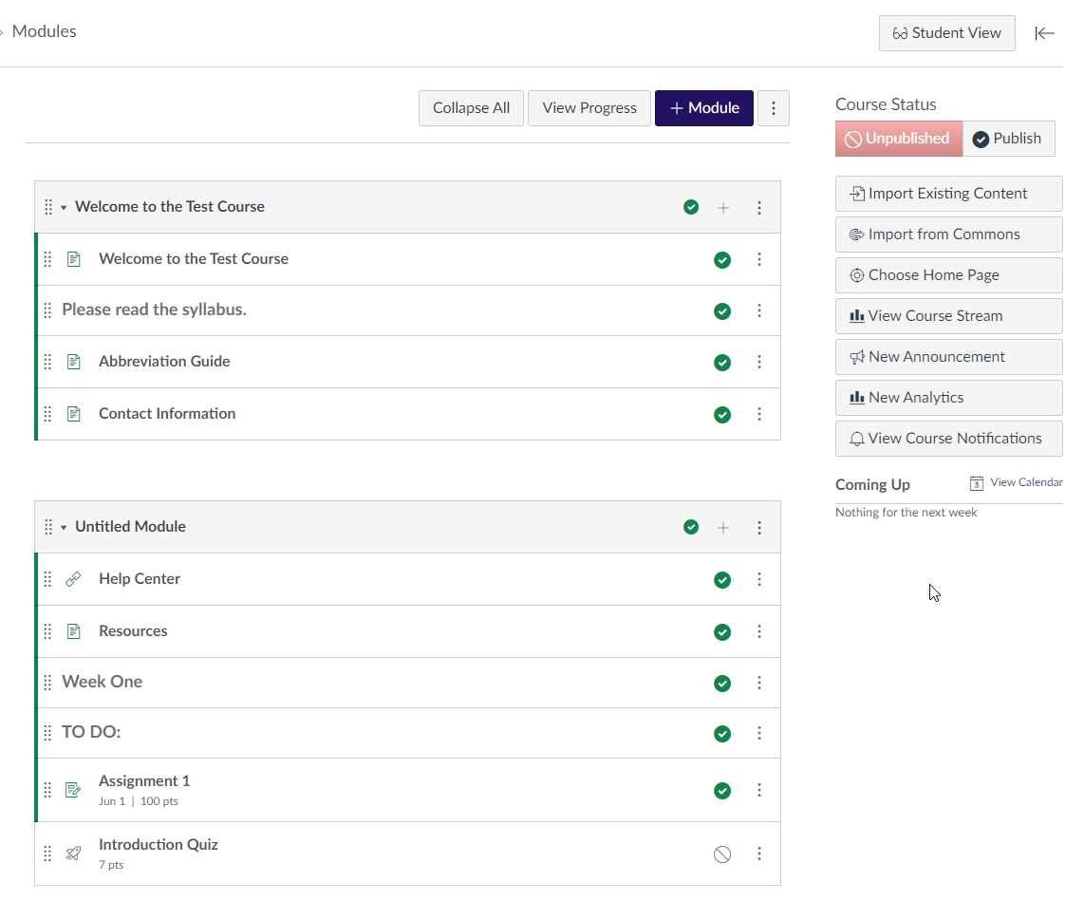
iLearn Sections
Canvas Modules

Slide 14
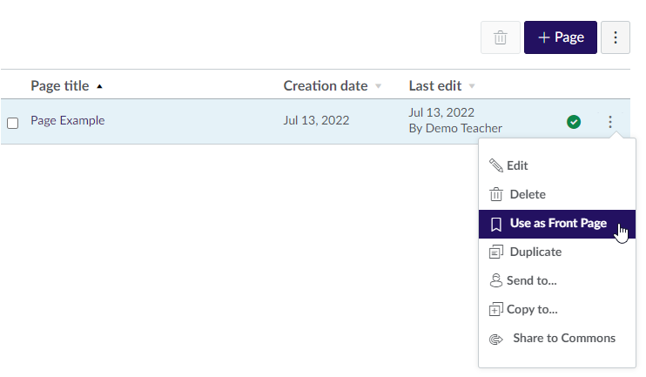
Setting a custom front page
Any page can turn into the front page of the class instead of the Modules section.
Allows for more customization and humanization.
Allows the course to behave like a book where students go through content sequentially.

Slide 15
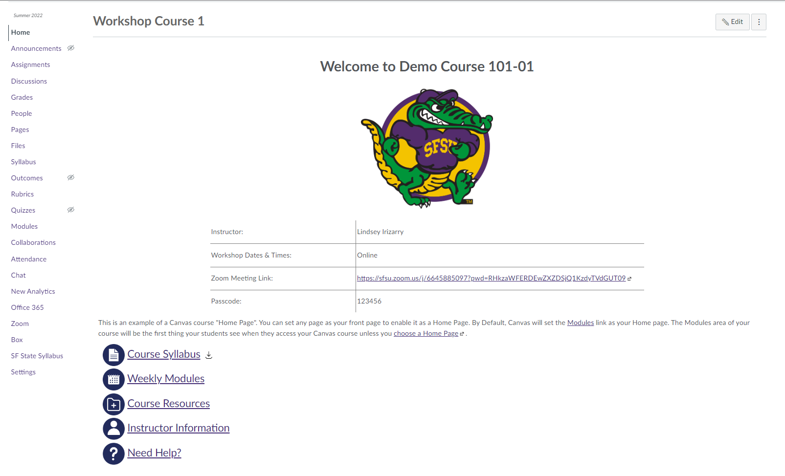

Slide 16
Modules vs
Pages
Modules
Add assignments, quizzes, discussions, files, and links using the + button.
Text headers
Indent levels
Pages
Add course links and external links
Colored and bolded/custom text
Pictures
Videos
Documents
Icons
Tables

Slide 17
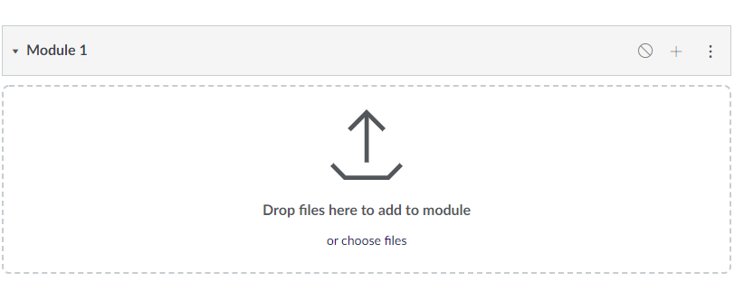
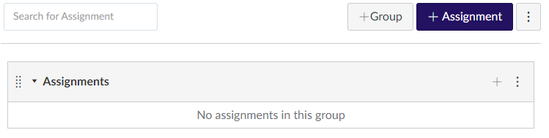
Adding content
Two ways
  + button in a module
  + button in each type of content

Slide 18
Student management

Slide 19
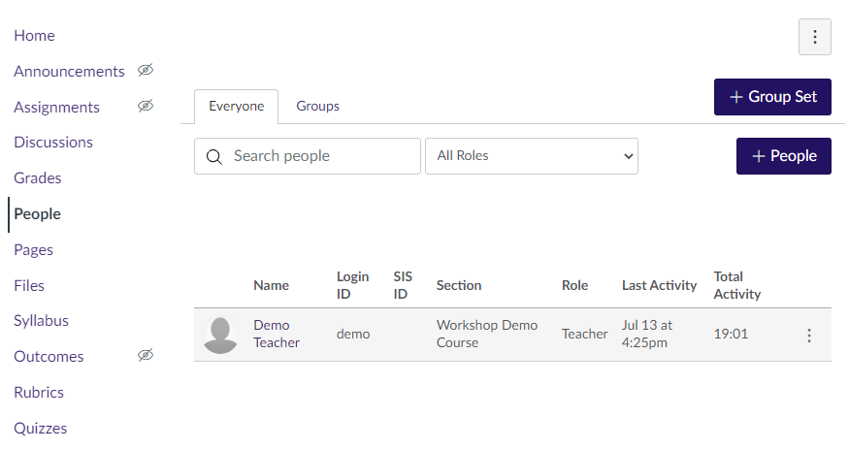
Viewing list of students
People link in course navigation on the left
Students are automatically added when they enroll
  Students do not need to be manually added to Canvas
  Canvas updates roster every two hours

Slide 20
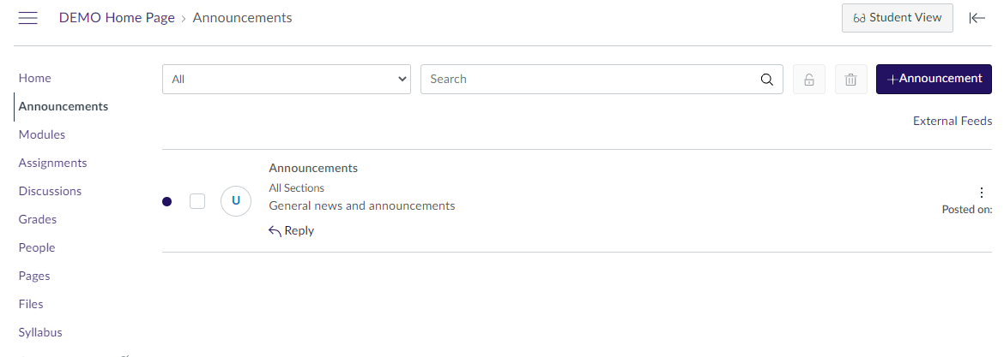
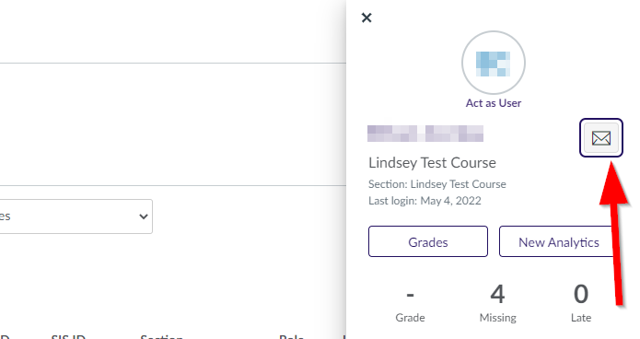
Messaging students
Announcements link in course navigation to send message to whole course
  Announcements are sent to email and Canvas’ messaging system by default
  Students who use the Canvas Student app also get a notification on their mobile device
Individual students can be messaged from the People page by clicking on the student’s name

Slide 21
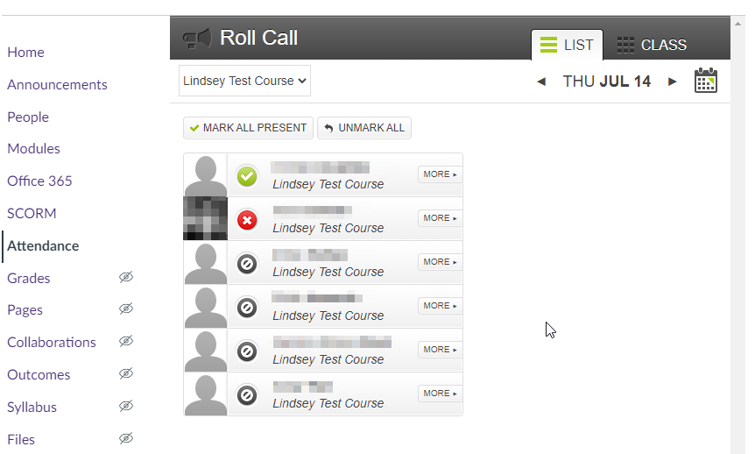
Attendance
Attendance link in course navigation.
Does not require you to create sessions.
Choose the date on the upper right and click on the bubble next to the student’s name to mark attendance.

Slide 22
Activities and grading

Slide 23
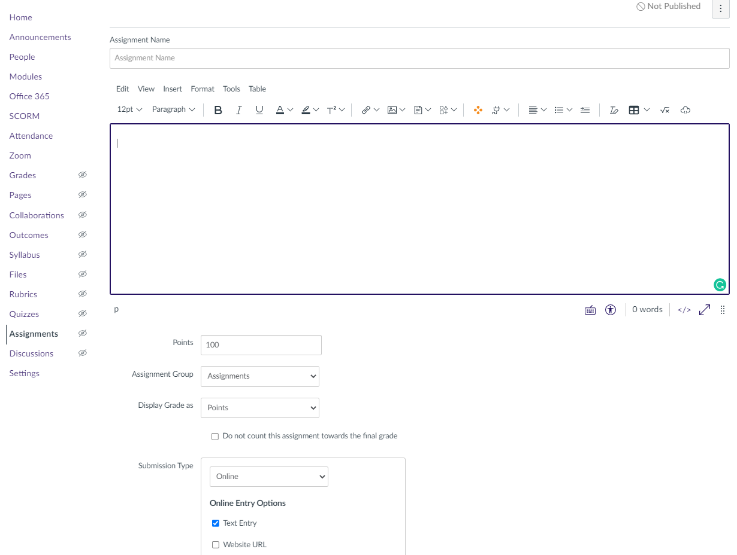
Assignments
Assignments can either be a file submission, online text entry, or no submission, grade only.
Assignments can be assigned to a group.
Assignments can have a peer review set up.
If courses are combined, assignments can be assigned to specific sections.
  Different sections can have different deadlines.
Notes:
Mention that due dates will need to be changed if they import assignments straight from iLearn

Slide 24
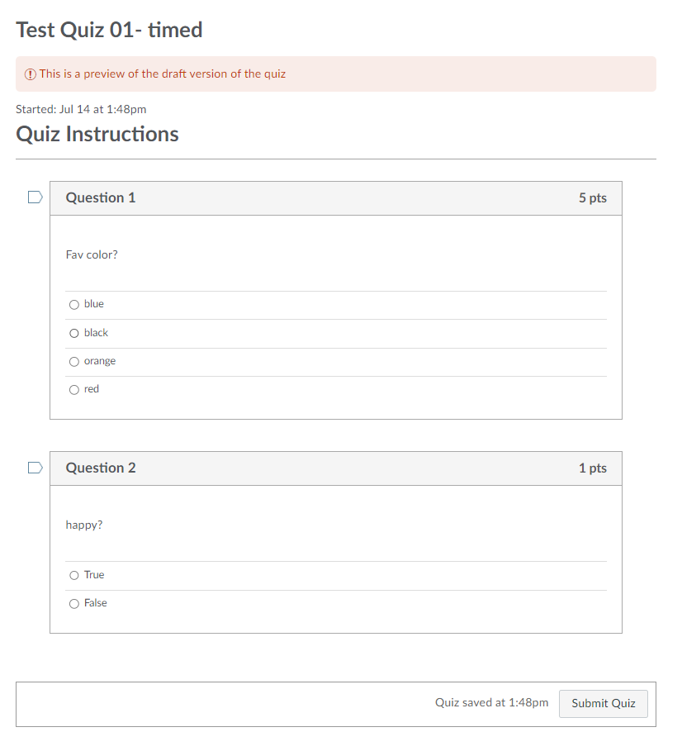
Quizzes
Question types available:
  Multiple choice
  True/False
  Fill in the Blank
  Fill in Multiple blanks
  Multiple Answers
  Multiple Dropdowns
  Matching
  Numerical Answer
  Formula question
  Essay question
  File upload question
  Text only (no question)
Notes:
Question answers can be shuffled. Not all question types from ilearn have a direct equivalent. If you import an iLearn course, questions come with it. Imported quizzes are not published manually

Slide 25
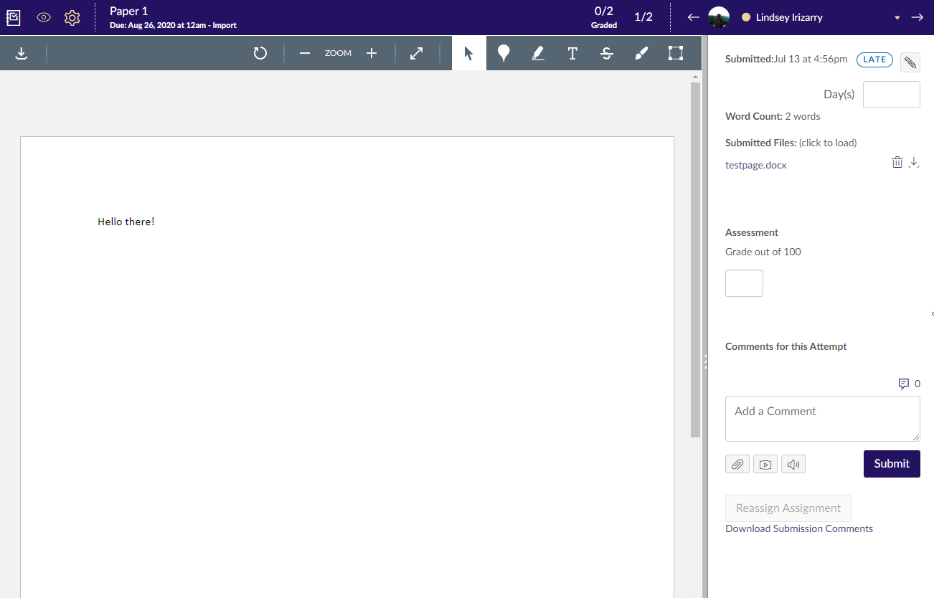
Speedgrader
Every graded activity can be graded using Canvas’ speedgrader tool
Quick way of entering grades and feedback student by student

Slide 26
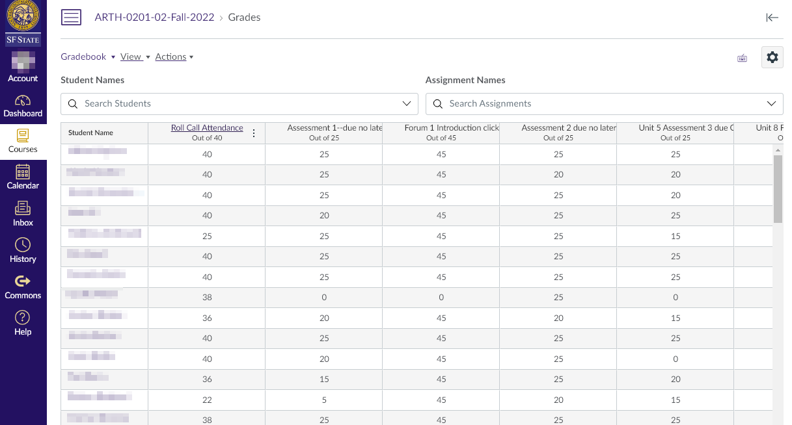
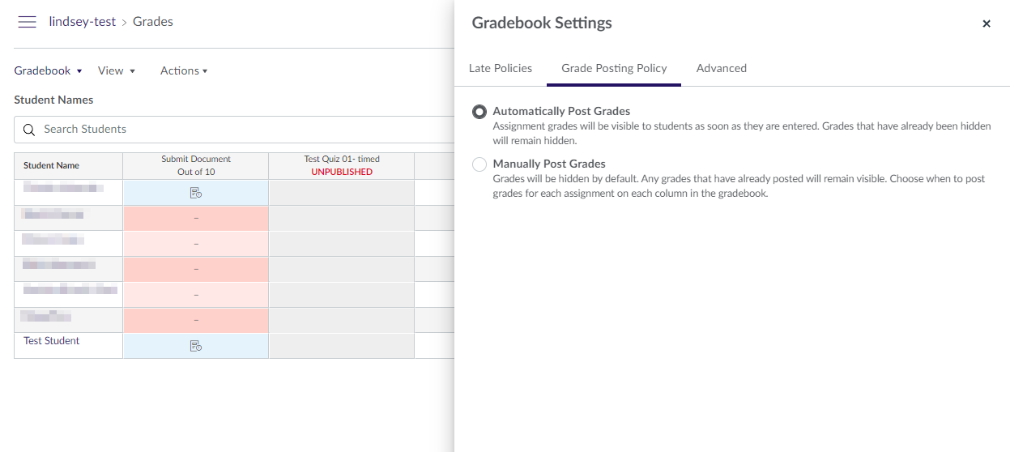
The gradebook
Grades link in course navigation.
Set up late policies, grade posting policy.
Weighted grades are setup using Assignment Groups.
Canvas’ philosophy is that students should be able to see everything all the time.
  Grades are automatically available to students whenever they are entered
  Limited ability to hide grades by design

Slide 27
External tools

Slide 28
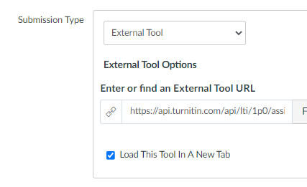
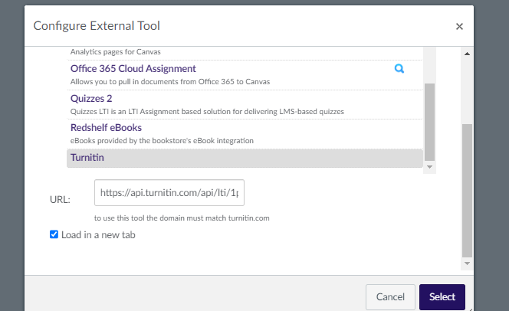
Turnitin
Create a new assignment and set submission type as External Tool.
Does not integrate with Speedgrader, uses its own grading tools.

Slide 29
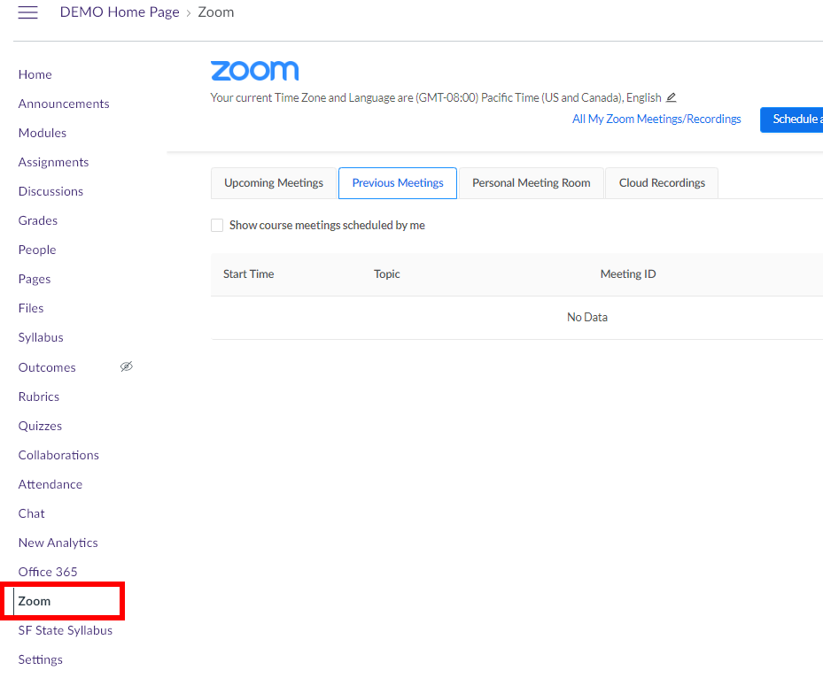
Zoom and Mediasite
Upload videos through Mediasite.
Zoom is one link in the navigation bar.
  All meetings are shown in the Zoom link
  All recordings (when published) are shown to students

Slide 30
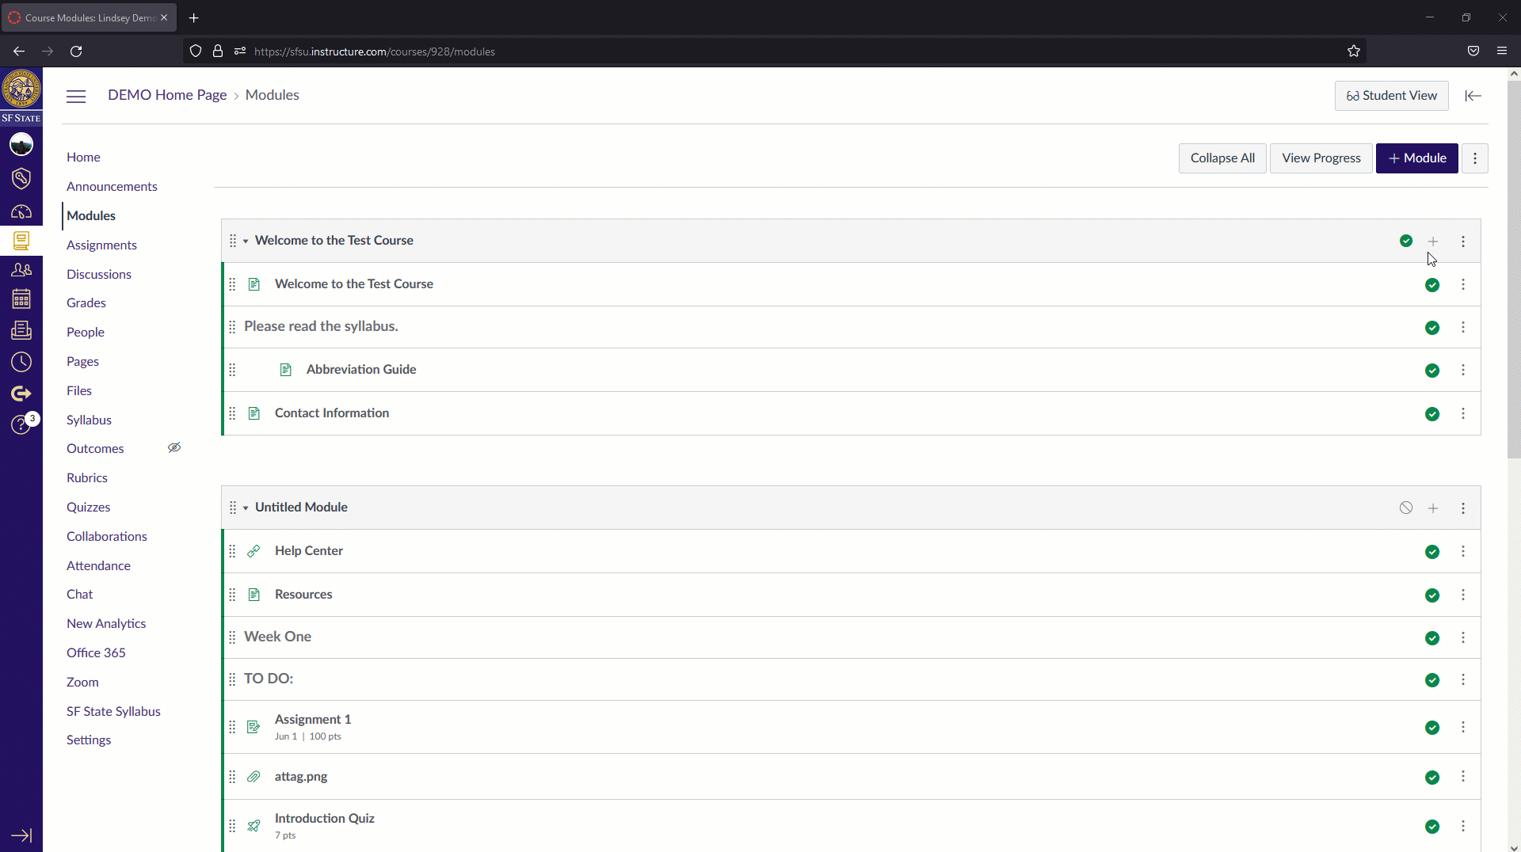
iLearn Video
Add existing videos to Canvas modules through the iLearn video external tool
Upload new media

Slide 31
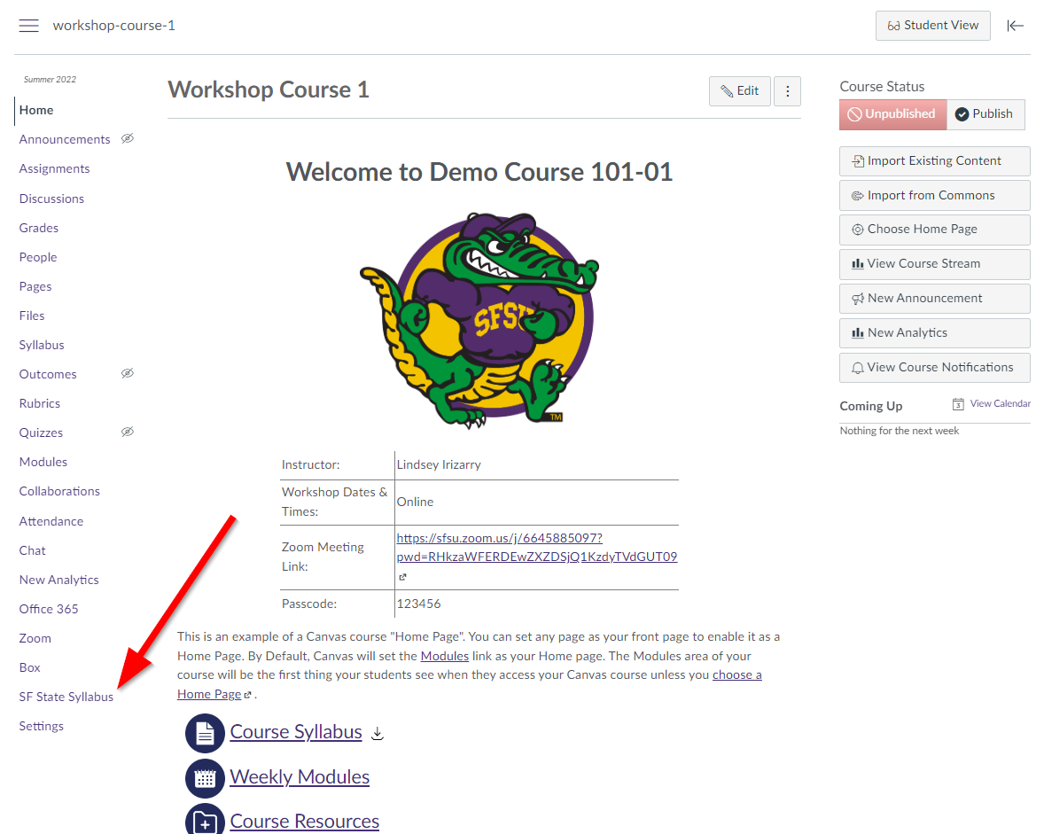
SF State Syllabus
SF State Syllabus tool is in the left navigation menu.
All pre-existing syllabi will be retained and are accessible through Canvas.

Slide 32
Third party tools
Third party tools, such as publisher tools, can be added to courses individually
Non-official third-party tools will not be integrated at the site level
  Publishers may indicate that this is the only way. This is false. Faculty can follow up with AT for more details if needed

Slide 33
Extras

Slide 34
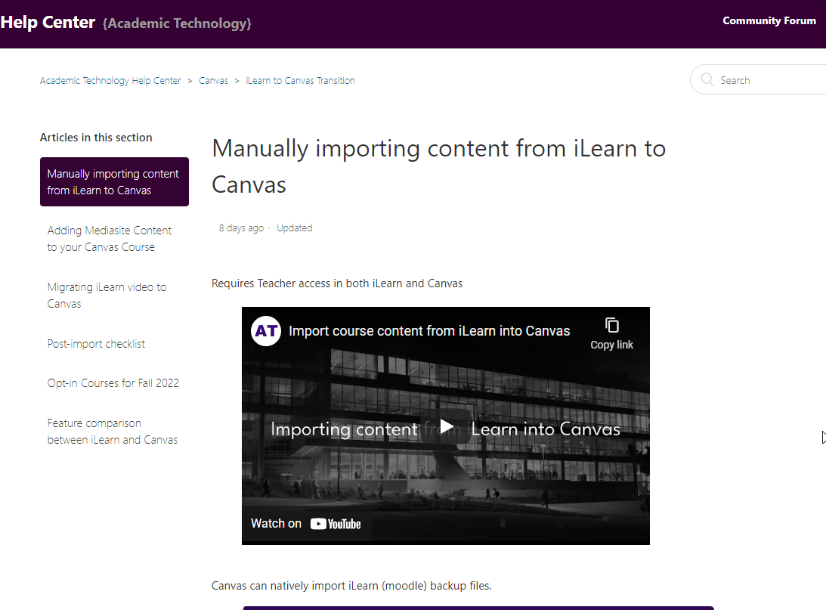
Importing content from iLearn
See guide - https://athelp.sfsu.edu/hc/en-us/articles/5690090704915-Manually-importing-content-from-iLearn-to-Canvas
Courses prior to Fall 2021 will need to be imported via this method.

Slide 35
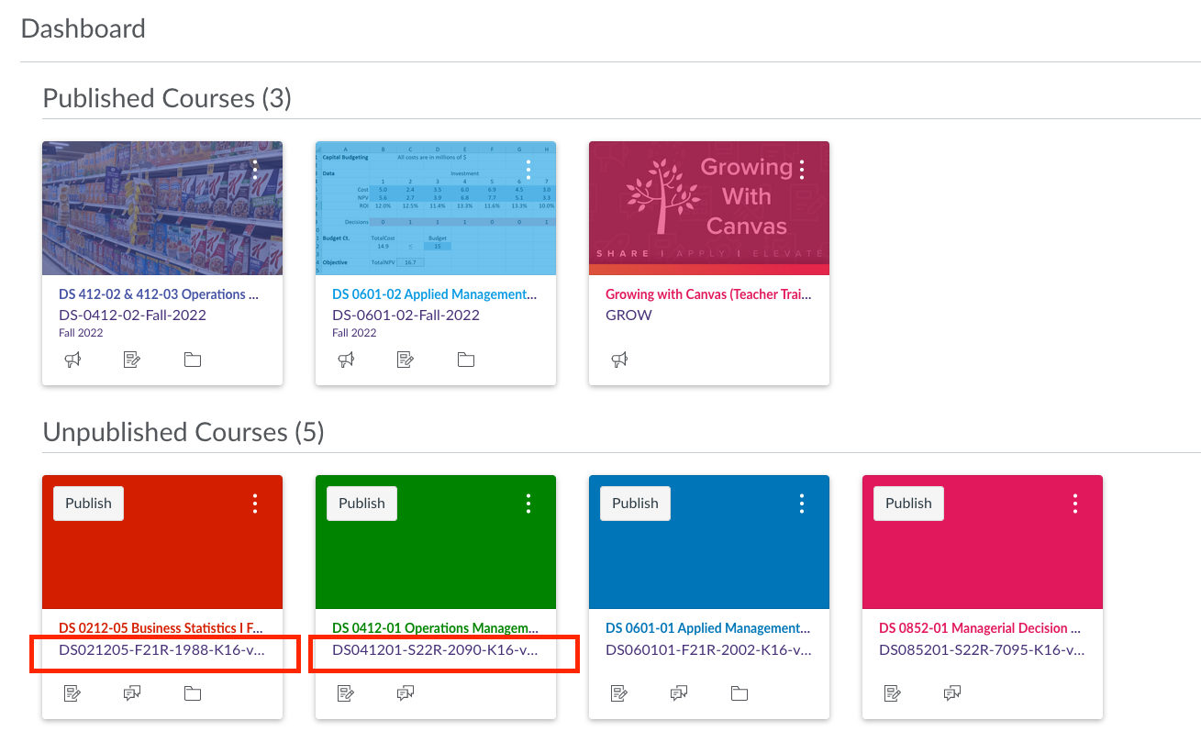
K16 course shells
Any course taught during the previous academic year (2021-2022) with content inside of its iLearn site carried over into Canvas.
Work off the K16 course to prepare for Spring 2023.

Slide 36
What to expect
Section summaries convert to a Page.
Activity descriptions displayed on the main course are found inside the activity itself.
Pictures convert to a file or a page.
Quizzes are unpublished.
Original due dates remain.
Labels convert to a page or text headers.
iLearn Videos need to be manually added.
Glossaries are not an available activity in Canvas.
Zoom links do not carry over.
Set aside time to review your course after an import from iLearn!

Slide 37
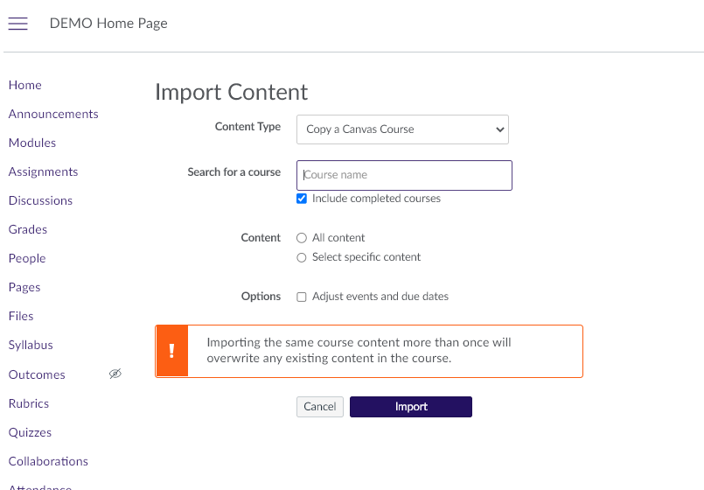
Copying one Canvas course into another
Your course material is NOT automatically imported into Spring 2023 courses.
See guide-
https://athelp.sfsu.edu/hc/en-us/articles/9184298875667-Copying-one-Canvas-Course-into-another-Canvas-course

Slide 38
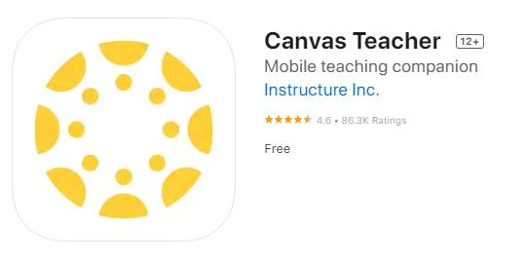
The teacher mobile app
Canvas Teacher app available on iOS and Android.
Allows interaction with courses on the go, including grading.

Slide 39
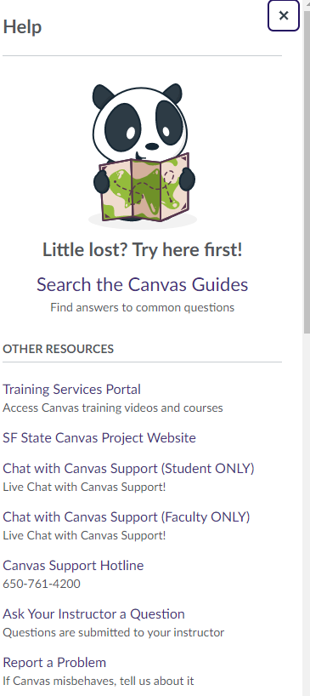
Quick Questions?
For additional support call us at (415)405-5555
OR
For 24 Hour support, chat with the Canvas Support Team via Canvas

